Slide 1
Web programming
Prof. Yousef B. Mahdy
Faculty of Computers and Information
Assiut University

Slide 2
Designing Web Pages
There are too many important facets to the language of the World Wide Web to say that any one is the most important. That language is called HTML. In the years since its inception, the HTML specification has been fairly dynamic.

Slide 3
Definitions
URL, or Uniform Resource Locator. The URL is the address of a particular item on the Internet.
This address can be part of either a domain name or an IP (Internet Protocol) address.
A URL using a domain name would look something like www.microsoft.com, and the file you're looking for might be in the directory /vbs.
You can just as easily use the IP address to get the file you're looking for. For the address www.microsoft.com, the numbers would be 198.105.232.5.
A complete URL contains a protocol prefix, such as http:// or ftp://, followed by the address and a port number-for example, http://www.microsoft.com:80.

Slide 4
client/server
The server is a machine that contains the content and the associated server software.
The client is a machine that is usually not a server but that connects to the server to retrieve content. In this book, you'll read a lot about what's happening on the server side versus what's happening on the client side.
In the case of the World Wide Web, the server is the machine that contains your published Web pages, and the client machines are those of people who are viewing your pages.

Slide 5
Bandwidth
Bandwidth determines speed at which you can move an amount of data between machines. Three broad types of bandwidth exist: low bandwidth, middleband, and broadband.
Low-bandwidth connections are analog connections with modems. Analog connections use sounds that must be translated into digital signals before a machine can understand them.
A middleband connection might be an ISDN or other digital connection. Digital connections are faster because they require no translation step, and the signal itself is usually cleaner.
A broadband connection might be a T1 connection or a cable modem. Right now, most client machines hook into the Internet in the low-bandwidth connection range.

Slide 6
Scripting
Scripting is about controlling objects. In the same way that a movie script helps to determine what actors do and say, the scripts that you write to control your HTML pages are plans for what the objects in your pages will do.

Slide 7
HTML
HTML isn't really a computer language in the strictest sense of the term. For the most part, HTML is a page-description language that determines how a page will look on the screen.
HTML is a standard that is maintained by the World Wide Web Consortium (W3C). W3C is a group of individuals and companies that develop and approve standards for the Web.
You design a web page so that people will come to the page and stick around for a while. You want to distribute information, you want to entertain, and most importantly you want your page to be worthy of a link on someone else's page.

Slide 8
Tag Basics
At its core, an HTML document is simply a plain text file containing special codes, called tags, that are usually placed around blocks of text.
These blocks and the tags that surround them are called elements. A Web browser such as Microsoft Internet Explorer interprets, or parses, these elements to determine what to display on the screen.
In most cases, each element has an opening tag and a closing tag. An opening tag consists of the tag name surrounded by angle brackets (the "<" and ">" characters).
For example, the boldface opening tag is defined as <B>. A closing tag is also enclosed by angle brackets, but in this case a forward slash precedes the tag name: </B>.
The affected text appears between the opening tag and the closing tag: when processed by the browser, the text between a <B> tag and its closing </B> tag is displayed in boldface.

Slide 9
Example 1:
This line produces a legal HTML document. Of course, there is nothing to see in the document. The point is that the tags don't show up in the document; only the formatted text does.
<HTML>
<HEAD>
<TITLE>Listing 2-1</TITLE>
</HEAD>
<BODY>
Yet another "Hello World!"
</BODY>
</HTML>

Slide 10
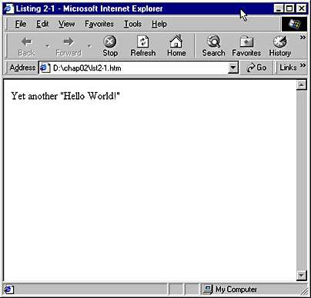

Slide 11
HTML Container Tags
The <HEAD> tag sets initial document information off from the rest of the document. That information can include <TITLE>, <META NAME>, and other document administration tags.
The <TITLE> tag tells the browser what you've named your page.
The title of the page usually shows up in the title bar of the browser with which you're viewing the page.
The <TITLE> tag is part of the <HEAD> tag in the HTML page.

Slide 12
The <BODY> Tag
The <BODY> </BODY> tags hold the content of your HTML document.
Text that is between these tags is formatted to the browser's default style.
Listing 1.1 shows a document that contains a line of body text. The style of text in the body of a document is determined by the tags that surround the text.

Slide 13
Character Formatting Tags
Code Listing 2-2 contains a variety of basic character formatting tags.
In the first line, the bold tags <B> and </B> surround the words bold text—and these words appear in boldface in Figure 2-2.
In the next line, the <I> and </I> tags italicize the words italic text.
Several other character formatting tags are shown, including <U> for underlining, <STRIKE> for strikethroughs, <KBD> for fixed-width type, and <SUB> and <SUP> for subscripts and superscripts.

Slide 14
Example 2:
<HTML>
<HEAD>
<TITLE>Listing 2-2</TITLE>
</HEAD>
<BODY>
This is some <B>bold text</B>.
This is some <I>italic text</I>.
This is some <U>underlined text</U>.
This is some <STRIKE>strikethrough text</STRIKE>.
This is some <KBD>fixed-width text</KBD>.
This is some <SUB>subscripted text</SUB>.
This is some <SUP>superscripted text</SUP>.
</BODY>
</HTML>

Slide 15
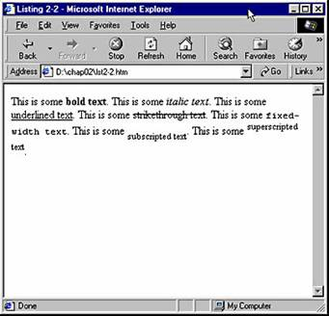
Output:

Slide 16
<FONT> tag
You can use the <FONT> tag to set up much more complex text formatting. This tag supports a variety of attributes, including COLOR, SIZE, and FACE, which detail exactly how the tag works. Many other tags support attributes, sometimes known as parameters.
In Code Example 3, the first <FONT> tag illustrates the use of the COLOR attribute, which allows you to change the color of text. The COLOR attribute supports a huge range of colors, from AliceBlue to YellowGreen. The COLOR attribute also supports hexadecimal triplet RGB values, which means that you can specify colors using hexadecimal numbers (such as #0000FF).
The next <FONT> tag includes the SIZE attribute, which lets you change the relative size of the text. You can set text size on a scale of 1 to 7, with 7 being the largest. These numbers do not correspond to any specific point or pixel size, and the same size setting can vary in appearance on different systems.

Slide 17
Example 3:
<HTML>
<HEAD>
<TITLE>Example-3</TITLE>
</HEAD>
<BODY>
<FONT COLOR="blue">Color!</FONT>
<FONT SIZE="5">Size!</FONT>
<FONT FACE="Courier">Typeface!</FONT>
<FONT SIZE="6" COLOR="blue" FACE="Arial">Many Changes!</FONT>
</BODY>
</HTML>

Slide 18
The third <FONT> tag in Code Listing 2-3 uses the FACE attribute to change the typeface (font) of the text.
In HTML, a single tag can have multiple attributes. For instance, the final <FONT> tag in Code Example -3 produces large blue text in the Arial typeface because its SIZE attribute is set to 6, its COLOR attribute to blue, and its FACE attribute to Arial. The attributes could have been listed in any order with the same results.

Slide 19
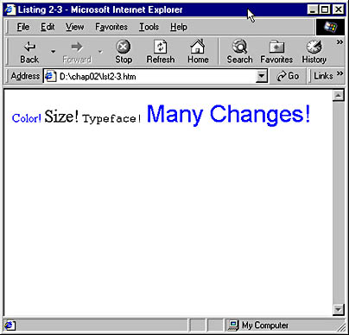

Slide 20
Line Formatting Tags
HTML standards state that browsers should ignore line endings (linefeeds and carriage returns,….) in the source text file.
The <P> and </P> tags in the first two lines of the body in Code Examle-4 define a block of text as a paragraph. The closing </P> tag is optional.
<P>This is a paragraph.
<P>This is another.</P>
The next two lines in Code Example-4 demonstrate level-one and level-two headings. Like a paragraph, a heading has space before and after it. Each heading level is associated with a specific font size. HTML defines six levels of built-in headings.
The final lines of Code Example-4 demonstrate the break tag, <BR>. This tag inserts a line break, but unlike the <P> tag it doesn't insert any extra blank lines. You don't need to add a closing </BR> tag because a break does not define a region of text. Rather

Slide 21
Example -4
<HTML>
<HEAD>
<TITLE>Example-4</TITLE>
</HEAD>
<BODY>
<P>This is an example of a paragraph.</P>
<P>This is another paragraph.</P>
<H1>This is a level-1 heading.</H1>
<H2>This is a level-2 heading.</H2>
This is not followed by a break.
This <B>is</B> followed by a break.
<BR>
This is not followed by a break.
This is not followed by a break.
</BODY>
</HTML>

Slide 22
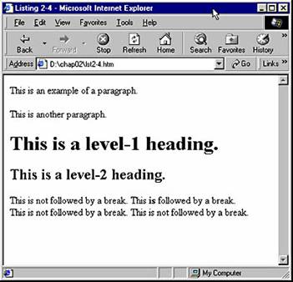

Slide 23
Headings
Heading levels in HTML documents range from <H1> to <H6>. In most browsers, the size and weight of heading text is largest at <H1> and smallest at <H6>. Listing 1.2 shows you how the heading levels are set in the HTML document.

Slide 24
Example -5
<HTML>
<HEAD>
<TITLE>Heading Levels in an HTML Document</TITLE>
</HEAD>
<BODY>
<H1>Heading 1</H1>
<H2>Heading 2</H2>
<H3>Heading 3</H3>
<H4>Heading 4</H4>
<H5>Heading 5</H5>
<H6>Heading 6</H6>
</BODY>
</HTML>

Slide 25
PRE, and HR tags
There may be times when you want to force the Web browser to ignore its white space rules and break the lines of text where your code has line breaks and put spaces where you have spaces. This is accomplished with the <PRE> tag, shown in Code Example-6, which tells the browser that you have preformatted the upcoming text.
Code Example -6 also demonstrates the horizontal rule tag, <HR>, which creates a horizontal line, or rule, across the page.
Two common attributes used with the <HR> tag are SIZE and WIDTH.
SIZE determines the thickness of the rule in pixels, which can vary from 1 to 100 pixels. The default SIZE is 2.
WIDTH controls the width of the rule, which you can set to a specific number of pixels or to a percentage of the available space on the screen. Thus, <HR WIDTH="50"> creates a horizontal rule that is 50 pixels wide, while <HR WIDTH="50%"> draws a rule that is 50 percent of the width of the browser window. The default width is 100 percent.
Finally, in Code Listing 2-5 we see an example of the no-break tag, <NOBR>. Anything inside a <NOBR> element will not break at the end of a line. This can be very helpful if you want to keep words or graphics together on the same line. For example, there might be a legal requirement for a product's name to be displayed entirely on one line.

Slide 26
Example - 6
<HTML>
<HEAD>
<TITLE>Example - 6</TITLE>
</HEAD>
<BODY>
<PRE>
This is an example of some
preformatted text.
Notice how the page
is displayed with the same spacing and
line breaks as the code.
</PRE>
<HR>
<HR WIDTH="50%" SIZE="6">
One of these lines uses no-break and one does not.
<NOBR>One of these lines uses no-break and one does not.</NOBR>
</BODY>
</HTML>

Slide 27
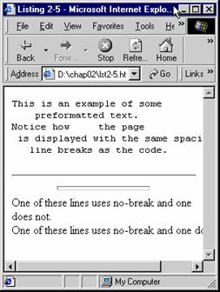

Slide 28
The horizontal margins can be eliminated by setting the LEFTMARGIN attribute of the <BODY> tag to 0. The vertical margins can be eliminated with the TOPMARGIN attribute. Thus, the following <BODY> tag would completely eliminate margins around the page.
<BODY LEFTMARGIN="0" TOPMARGIN="0">
You can also increase the margins around the page by increasing the values of these attributes.

Slide 29
Alignment Attributes and Tags
HTML also lets you control the horizontal position of elements on the page. Code Example -7 demonstrates two methods.
By default, Web browsers align all text along the left side of the screen (left-aligned).
One way you can change this is by using the ALIGN attribute. Several tags support the ALIGN attribute, including <P> and all the heading tags.
In the first three lines in the body of Code Example 7, ALIGN is used to left-align text, center it on the screen, and right-align it. Because centering text is extremely common, this action has its own tag, <CENTER>, as you can see in the last line of the body. The browser will center on the page any text between the <CENTER> and </CENTER> tags.

Slide 30
Example -7
<HTML>
<HEAD>
<TITLE>Listing 2-6</TITLE>
</HEAD>
<BODY>
<P ALIGN="left">This text is left-aligned.</P>
<H2 ALIGN="center">This text is centered.</H2>
<H5 ALIGN="right">This text is right-aligned.</H5>
<CENTER>This text is also centered.</CENTER>
</BODY>
</HTML>

Slide 31
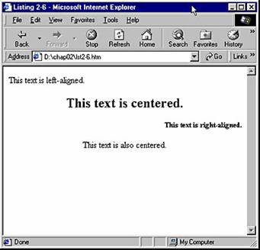

Slide 32
Image and Hyperlink Tags
Images and hyperlinks provide some of the most powerful benefits of HTML.
Internet Explorer allows you to display a variety of graphics types, the most common being GIFs and JPEGs (Graphics Interchange Format and Joint Photographic Experts Group, two widely used graphics file formats).
A hyperlink defines a region of the screen that the user can click to go to another Web page or to a specific place on the same page.
Code Example - 8 contains both images and hyperlinks.

Slide 33
Example -8
<HTML>
<HEAD>
<TITLE>Example 8</TITLE>
</HEAD>
<BODY>
Here is an image <IMG SRC="sample.gif" WIDTH="20" HEIGHT="36">.
<BR>
<IMG SRC="sample.gif" WIDTH="20" HEIGHT="36" ALIGN="right">
This image has been given an alignment. This causes the image to be removed from the flow of the text and displayed at a particular location relative to the surrounding text.
<BR>
Here is a <A HREF="http://www.microsoft.com">link to Microsoft</A>.
<BR>
The next link has a picture and text and links to a local file.
<BR>
<A HREF="other.htm"><IMG SRC="sample.gif"> text</A>
<BR>
This final link points to a bookmark in the file "other.htm".
<BR>
<A HREF="other.htm#bookmark1">Link to bookmark</A>
</BODY>
</HTML>

Slide 34
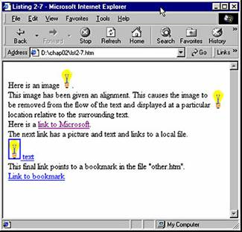

Slide 35
IMG Tag
The <IMG> tag is used to place an image on a page. The closing tag </IMG> is optional and is almost never used. An image is an in-line element by default, which means that it moves along with any text, just as a word does. Inclusion of an image affects the way lines wrap, and the image itself is affected by settings that influence text, such as margins.
The most important is the SRC attribute, which contains a path to the source graphics file. In Code Example 8, we used the name of a local graphic.
You can also set the SRC attribute to point to graphics files in other locations, such as another directory on the same computer or a graphics file on another Web site.
For another Web site, provide the full Web location of the file, preceded by http://: for example, http://www.microsoft.com/library/images/gifs/logos /ieget_animated.gif. The http:// tells the browser to access the file using HTTP, which is used to transfer most files over the Web.

Slide 36
IMG Tag
Two other attributes commonly used in <IMG> tags are WIDTH and HEIGHT. Both are expressed in pixels.
Specifying values for the WIDTH and HEIGHT attributes allows the browser to reserve space on the screen before the actual images are downloaded. This method offers a significant advantage to users who have slow Internet connections because it enables their browsers to display correct page layouts quickly.
Setting the WIDTH and HEIGHT attributes to values other than the true width and height of an image causes the browser to scale the image to the dimensions specified.

Slide 37
IMG Tag
The second <IMG> tag in Code Example 8 demonstrates the ALIGN attribute.
This attribute causes the image to no longer be displayed in line with the text. Instead, the image is displayed at a particular location relative to the text that follows it.
Valid values for ALIGN include top, bottom, middle, left, and right, which do exactly what you would expect.
Less obvious values are absbottom, absmiddle, baseline, and texttop, which give greater alignment control by incorporating information specific to the font being used when calculating where to position the image.
Many other elements support the ALIGN attribute, including TABLE and FIELDSET.

Slide 38
Links in Your Documents
To link to a specific location within an HTML file, you need to have tags inside the file to set the places to which you would like to go. These tags are called anchors.
You set an anchor using the NAME= attribute with the <A> tag:
<A NAME="Anchor">This line will be at the top of the page</A>
To set a link to that anchor, simply reference the anchor as you would a URL, using the HREF= attribute:
<A HREF="#Anchor">Link to Anchor</A>

Slide 39
hyperlinks
Code Example 8 also illustrates the use of hyperlinks.
A hyperlink is enclosed by the anchor tags <A> and </A> and is usually formatted as blue and underlined. When the user moves the mouse over a hyperlink, the mouse pointer changes to a pointing hand. Clicking the link causes Internet Explorer to open up the page specified in the link.
The anchor tag supports an HREF (hypertext reference) attribute, which defines the location the browser should go to. This location can be any valid Web location.
The first hyperlink in Code Example 8, we chose http://www.microsoft.com. If we had not preceded the location with http://, the browser would look on the current server for a folder named www.microsoft.com, which does not exist.
You can also set the HREF attribute to a local file, as we did in the second anchor in the sample. Setting the location to other.htm causes the browser to try to open a file named other.htm in the same directory as our sample file.

Slide 40
Links in Your Documents
If we had set the location to more/other.htm, the browser would have looked for other.htm in a more subdirectory of the directory that contains our sample file.
It is also possible to reference a named bookmark on a page, a technique often used in large documents. The last anchor in Code Example 8 contains such a reference. When it is clicked, Internet Explorer opens the other.htm file and then scrolls through until it reaches the specified bookmark.
For files that are at the same Web address as the file containing the link, all that is needed to open a particular file is the relative path and filename:
<A HREF="page.htm">Page in same directory.</A>
<A HREF="\docs\page.htm">Page in subdirectory.</A>
<A HREF=".\pages\page.htm">Page in another directory.</A>

Slide 41
Linking from Images
Creating a link from an image file is much like creating a hyperlink in text. Simply place the <IMG SRC= > tag in the same place that you would usually have text:
<A HREF="http://www.microsoft.com/"><IMG SRC="bestwith.gif" ALT="Internet Explorer 3.0" BORDER=0></A>
Notice that we've added the BORDER=0 attribute to keep a border from being displayed around the link. In addition, we've added the ALT= attribute so that text will be displayed during the graphics download and in case the user stops loading the page before the download is complete.

Slide 42
Multimedia in HTML
Multimedia is one of the main topics of this book. A large part of creating active content in HTML has to do with utilizing the multimedia features of HTML.
Sound
  In HTML, there are two ways to use sound in native formats with Internet Explorer 3.0. One way is to simply link a URL to a sound file in the Web page for playback on the client machine.
  The other way is with the <BGSOUND= > tag, which allows you to specify a WAV or a MID file to be played as a background sound while the page is being viewed. The file can be played once (by default) or repeated.

Slide 43
Multimedia in HTML
Video
  Video files can be used within a Web page in the same way as image files.
  The <IMG> tag, along with the DYNSRC= attribute, is used to place an AVI file into a Web page, as shown in Listing 1.3.
  Placing an SRC= attribute in the tag allows an image to be placed in the file for browsers that aren't capable of playing AVI files or for low-bandwidth machines where the user has opted to turn off the browser's video capabilities.
  If you want to make a small file play indefinitely, you would use the LOOP=INFINITE attribute.
  You can set the starting point of an AVI file with the START= attribute. Choices for the START= attribute include FILEOPEN, which runs the file as soon as it's loaded, or MOUSEOVER, which runs a file when the mouse passes over it.

Slide 44
Scripting
Scripting allows you to take control of content in an HTML document. Like any other tag in HTML, the <SCRIPT> tag uses attributes and allows you to define a scripting language to control the objects in your document. Objects in your document can range from active controls and Java applets to OLE server applications.
The LANGUAGE= attribute sets the scripting language in the <SCRIPT> tag. For VBScript, the language tag is "VBScript". The VBScript code itself is closed with the </SCRIPT> tag. To keep browsers that cannot use the code from displaying the code in a page, comment tags should surround the code:

Slide 45
Scripting
<SCRIPT LANGUAGE="VBScript">
<!-- SUB Button1_OnClick()
MsgBox "Welcome to the future.", 0, "Internet Explorer 3.0"
END SUB -->
</SCRIPT>
When the HTML document is loaded into the browser, the browser sees the <SCRIPT> tag, and the code is sent to the interpreter. VBScript then compiles the code and runs the program.

Slide 46
Constructing Lists
HTML includes a set of tags that allow the creation of hierarchical bulleted lists. There are two types of lists: unordered and ordered. Unordered lists are bulleted, whereas ordered lists are usually numbered. You can also combine the two types to create more complex lists.

Slide 47
Unordered Lists
The first list in Code Example 9 is constructed using only the unordered list tags, <UL> and </UL>. By placing one set of unordered list tags within another, we can embed lists within one another to create a series of indented pieces of text.
The next list shown in Code Example 9 also begins with the unordered list tag, <UL>. A closing tag, </UL>, is necessary, and it appears at the end of the list, toward the end of the file. Anything between these two tags is considered part of the list. This list contains bulleted line items, preceded by the list item tag, <LI>.
The ending tag, </LI>, is not required since anything encountered before another item begins or before the end of the list is considered part of the current list item.
Another list is embedded in this list. Notice that this embedded list is indented and that its bullets have a different shape. Only the first three levels of embedding have differing types of bullets. Beginning with the third level, all lists use the same style bullet. Notice that the second level does not have any text after the <UL>. Such header text is optional.

Slide 48
Example 9
<HTML>
<HEAD>
<TITLE>Listing 2-8</TITLE>
</HEAD><BODY>
<UL>This is at the first level.
<UL>This is at the second level.</UL>
<UL>This is at the second level.
<UL> This is at the third level.</UL>
</UL>
<UL>This is at the second level.</UL>
</UL>
<HR>
<UL>This is the first level header.
<LI>This is the first level-1 item in the list.
<LI>This is the second level-1 item in the list.
<UL>
<LI>This is the first level-2 item in the list.
<LI>And this is the second level-2 item in the list.
</UL>
<LI>This is the third level-1 item in the list.
</UL>
</BODY>
</HTML>

Slide 49
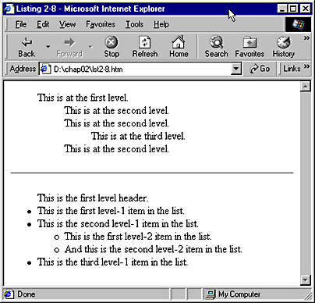

Slide 50
Ordered Lists
The line items of an ordered list are displayed with numbers rather than with bullets. Use the <OL> tag to set up an ordered list, as shown in Code Example 10.
The list in Code Example 10 begins with the ordered list tag, <OL>.
As is the case with an unordered list, a closing tag (</OL>) is necessary. Each list item is now preceded by a number rather than by a bullet.
Notice that a second list is embedded within the first and that the numbering restarts with 1 in this second list.

Slide 51
Example 10
<HTML>
<HEAD>
<TITLE>Listing 2-9</TITLE>
</HEAD>
<BODY>
<OL>
<LI>This is the first level-1 item in the list.
<LI>This is the second level-1 item in the list.
<OL>
<LI>This is the first level-2 item in the list.
<LI>And this is the second level-2 item in the list.
</OL>
<LI>This is the third level-1 item in the list.
</OL>
</BODY>
</HTML>

Slide 52
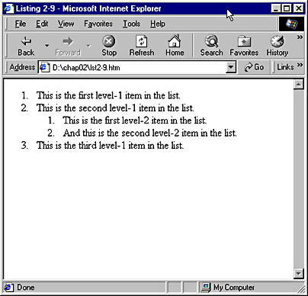

Slide 53
Complex Lists
The <OL> tag supports an attribute named TYPE, which controls whether the list items are prefaced with numbers, letters, or roman numerals.
Code Example 11 demonstrates the TYPE attribute as well as the mixing of <OL> and <UL> tags.
By combining ordered and unordered lists and by using the TYPE attribute, you can present complex hierarchical information.

Slide 54
Example 11
<HTML><HEAD><TITLE>Example 11</TITLE></HEAD><BODY>
<OL TYPE="1">
<LI>This uses numbers.
<OL TYPE="A">
<LI>This uses uppercase letters.
<OL TYPE="a">
<LI>This uses lowercase letters.
<OL TYPE="I">
<LI>This uses uppercase roman numerals.
<OL TYPE="i">
<LI>This uses lowercase roman numerals.
<LI>This also uses lowercase roman numerals.
</OL>
</OL>
</OL>
</OL>
<UL>
<LI>Here is a bullet.
</UL>
</OL>
</BODY>
</HTML>

Slide 55
